Slide 1

FIDES DVPN
WEB3 INFRASTRUCTURE

Slide 2
CONTENTS
WE HAVE MADE
GREAT CHIEVEMENTS
01
02
03
04
Introduce
Technical Feature
Network Modules
RoadMap

Slide 3
W
Fides DVPN
web3 Infrastructure
WEB3
FIDES means trust, honesty, faith, or loyalty. It is also the name of the goddess of faith in Roman mythology.

Slide 4

FIDES INTRODUCE
What is Fides DVPN
The FIDES DVPN creates infrastructure to decentralize VPNs while protecting networks and making them profitable by bandwidth farming for token rewards.
Target Market
Sharding nodes with high throughput serve specific businesses
Full stack encryption of business data
High-quality distributed computing
Technical Features
Users who surf the internet with privacy protection and data bandwidth transmission.
Vision
FIDES DVPN aims to build a decentralized, secure, efficient, and fair network connection platform.

Slide 5

Technical Features
FIDES DVPN combines advanced concus and encryption algorithms, peer-to-peer protocols, token incentives, and DAO governance to provide users with a more free, private, and high-quality DVPN service.

Slide 6
Fides DVPN Features
Complex Calculations
Massive users capacity
Data privacy protection
High scalability & flexible combination
Distributed computing
The sharding network provides distributed computing power and performs distributed computing for complex model disassembly of molecular tasks.
Multitasking in parallel
The workload sharding nodes are assigned tasks and aggregated task execution results by the computing task scheduling center
Low cost hardware
Any idle server equipment and bandwidth traffic can be used as nodes to provide services at low cost.
High throughput
The sub-chain consensus sharding provides Fides with exclusive blockchain throughput, and the workload sharding provides data transmission and computing capabilities.
Security and privacy
The protocol subnet provides security for the blockchain, and full-stack encryption of network data transmission ensures application data security and privacy are protected.
Resist single point of failure
Distributed multi-centralized nodes form a network cluster to prevent centralized blockade and no intermediate data is retained.
Module combination
Can be combined to
provide privacy security and network acceleration for applications, and serve cross-border and cross-regional computing power distribution
High network scalability
Workload sharding network nodes can add new features, new functions, and are easy to expand

Slide 7
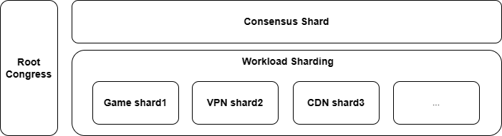
The sharding architecture provides powerful computing power and encryption features
CBP Algorithms
Consensus Byzantine Paradigm
FTS+POS，Responsible for building the main chain sharding consensus network and the business sharding network through election, as well as verifying new nodes joining, monitoring node consensus, and rotating node election and other functions
Consensus Congress
Workload Shard
A main chain sharding consensus network, with 600 members per shard, using the security mechanism of Zilliqa
Service Shard
The sharding network maintains a consensus block of a local-channel, which is guaranteed the it's own characteristics

Slide 8
Fides DVPN Network Node
A
Validator
B
Auditor
C
Worker
All nodes in the consensus shard form a set of validator to ensure that the consistency of blockchain transactions is verified and consensus reached.
Auditor ensures that the workload submitted by all workers in the workload shard is valid and correct, and submits a result of its own review to validator to prevent workers from submitting invalid or malicious workloads.
Workers complete workloads such as data routing, forwarding, data storage, encryption/decryption, etc. A collection of network nodes in Fides network that complete specific tasks.

Slide 9
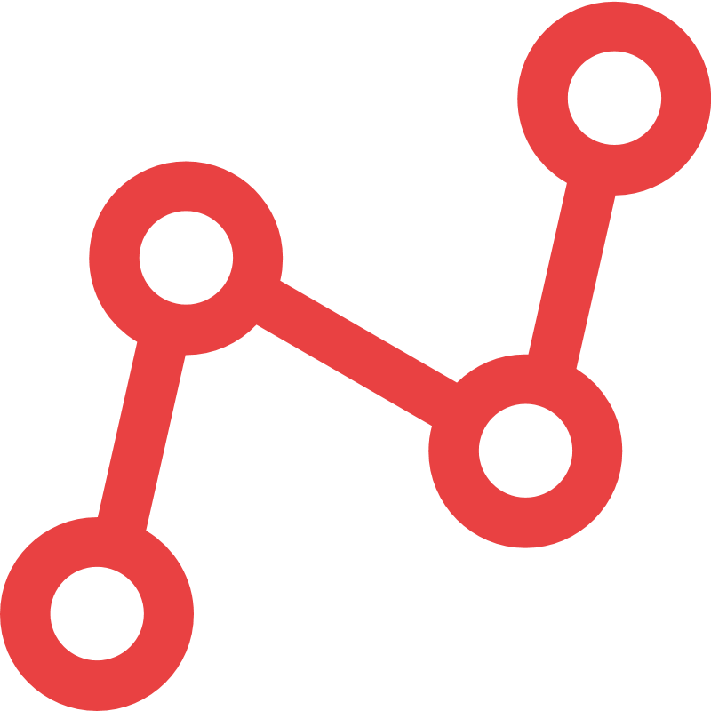
Fides DVPN Network
Concus Shard(Block Validator）worker Shard (Auditor and worker）
WEB 3 SDK&API
SE Middleware
Validator - Pledge FDS
Auditor and Worker- Pledge FDS
Developers develop WEB3 service based on Fides SDK & API
Developers pay FDS as the transaction fee
User pay the FDS as the fee to access Internet
SE
BaaS
NO
then out
stake & others’ condition
Yes then join in
Redeem & out
Consensus Shard
Workload Shard
SDK & API
Platform

Slide 10
Double encryption model
Internet
ECDH Algorithm
The public key and APP private key generate passwords and encrypt and decrypt them through algorithms
Signal and Data encryption and decryptionAuditor
The public key of Worker node and the private key of APP generate a password, which is encrypted and decrypted through the algorithm.
APP
Auditor
Validator
Worker
register
vote
Approver >=2/3
stake
Get Auditor & Worker Info
Encrypt Worker (Info+Request)
Select
Auditor
& Worker
Decrypt Worker Info
Encrypt Request
Decrypt Request
Access request
Get Data
Encrypt Data

Slide 11
Flexible and high computing service
Computing task
decomposition
The platform delivery task to Auditor, and Auditor splits the task into multiple subtasks.
Aggregate calculation
results
The subtasks are delivered to the Worker node for calculation. After the calculation results are obtained, the settlement results are aggregated and transferred back to the Auditor and finally returned to the computing platform
Task
Platform
Auditor
Validator
Worker
Get Auditor & Worker Info
configure Auditor
& Worker
post task
computing sub-task
split task -> sub-task
post subtask
return sub-task result
return result
combine result

